Slide 1



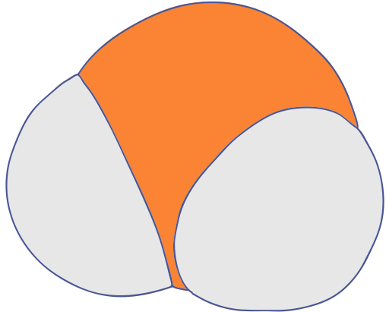






Production of BTX
(Benzene, Toluene & Xylene)
CL304 Chemical Process Technology
B
Benzene
Mrityunjay Sharma 210107054
Nandini Priya 210107055
Naresh Namdeo Thakare 210107056
T
Toluene
X
Xylene

Slide 2

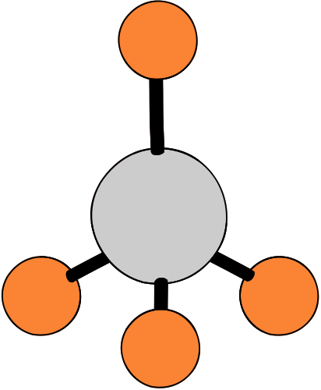
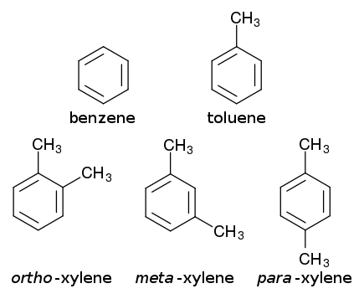
What is BTX?
Benzene
BTX, which stands for a blend of aromatic hydrocarbons including benzene, toluene, and the trio of xylene isomers, finds application in both petroleum refining and petrochemical sectors. These xylene isomers are identified by their respective ortho (o-), meta (m-), and para (p-) forms.
Toluene
Xylene

Slide 3

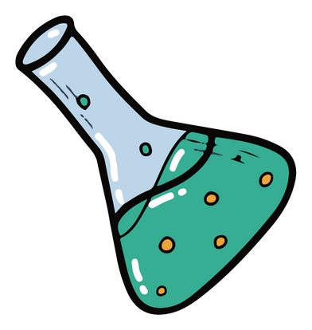
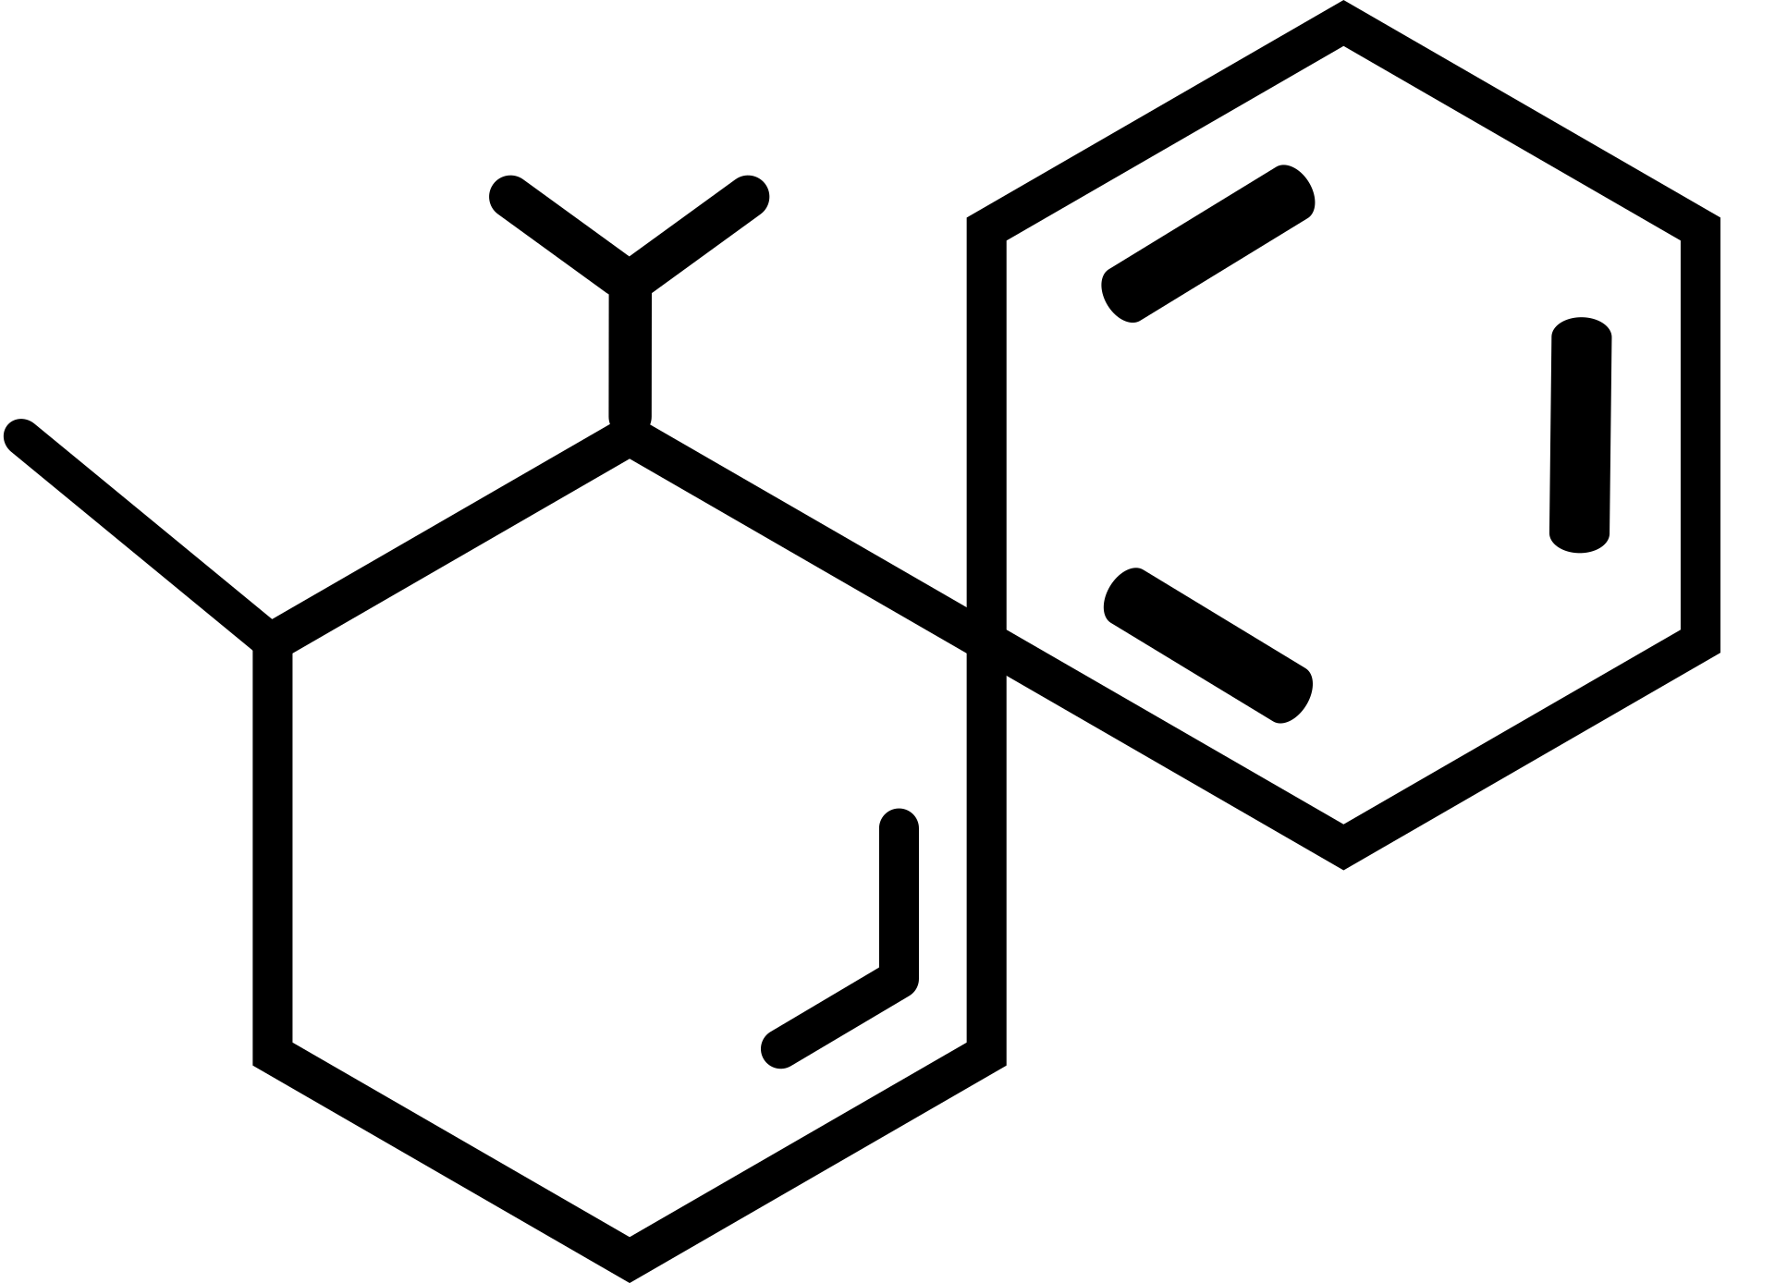
PHYSICAL PROPERTIES OF BTX
Benzene
Toluene
Xylene
Appearance & Volatility
Colourless and Volatile
Colourless and Volatile
Colourless and Volatile
Density(g/cm^3)
0.879
0.867
0.86-0.88
Melting Point
5.5°C
-93°C
meta - 13.3°C
ortho - 47.4°C
para - 51°C
Boiling Point
80.09 °C
110.6 °C
meta - 144.4°C
ortho - 139.1°C
para - 138.3°C
C6H6
C7H8
C8H10

Slide 4
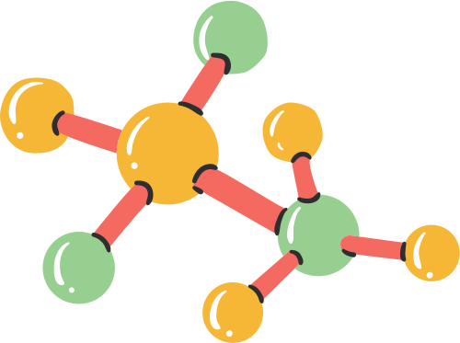
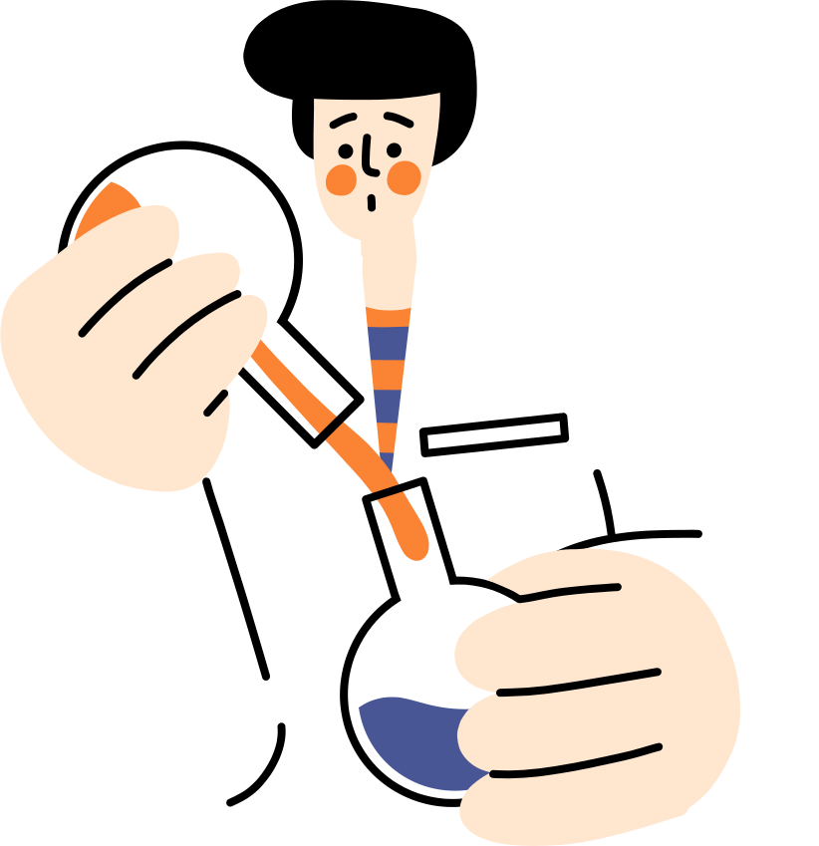

CHEMICAL PROPERTIES OF BTX
1
2
3
All components of BTX exhibit aromaticity, characterized by a ring of conjugated pi electrons, which imparts stability and reactivity.
BTX components are sparingly soluble in water but highly soluble in organic solvents due to their nonpolar nature.
They undergo typical aromatic substitution reactions such as electrophilic aromatic substitution and nitration..
Did You Know?
Xylene was used as a tear gas agent in World War I

Slide 5

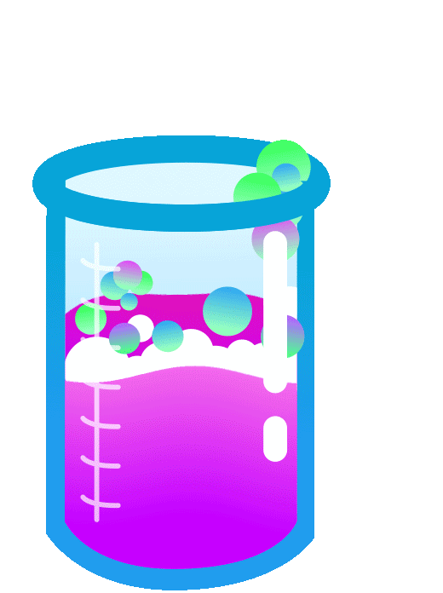
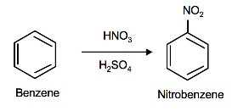
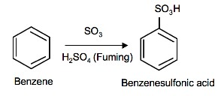
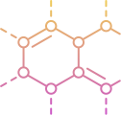
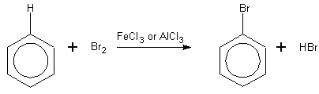
Some Common Substitution Reactions of BENZENE
N
NITRATION
S
SULFONATION
H
HALOGENATION

Slide 6
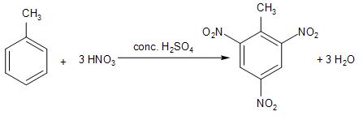
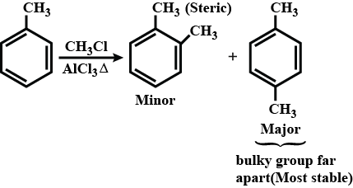
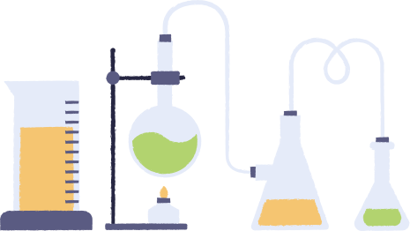
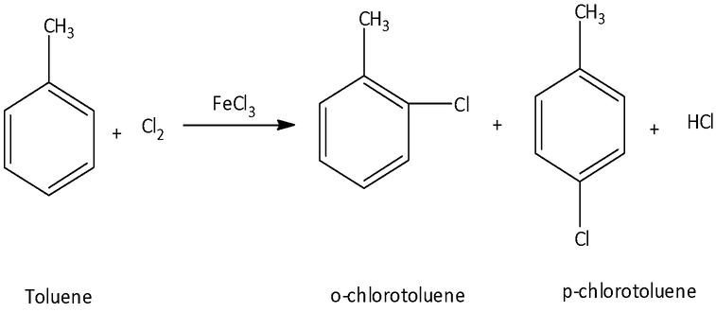
Some Common Substitution Reactions of TOLUENE
N
NITRATION
A
ALKYLATION
H
HALOGENATION

Slide 7
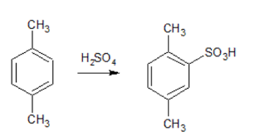
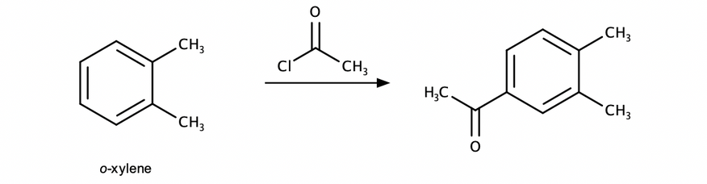
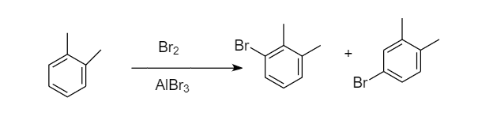
Some Common Substitution Reactions of XYLENE
S
SULFONATION
A
ACYLATION
H
HALOGENATION

Slide 8
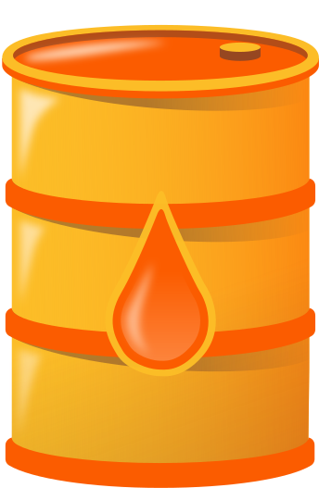

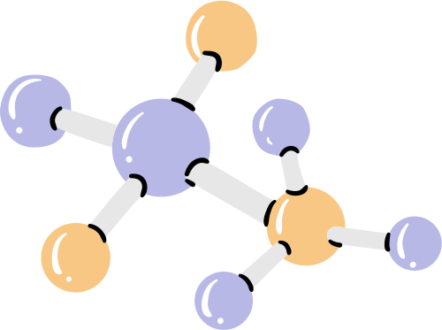
PRODUCTION OF BTX
CATALYTIC REFORMING OF PETROLEUM NAPHTHA
- Catalytic reforming of petroleum naphtha is a refining process aimed at converting low-octane naphtha fractions into high-octane gasoline blending components and valuable aromatic compounds like benzene, toluene, and xylene (BTX).
- The process involves subjecting the naphtha feedstock to complex chemical reactions over a catalyst at elevated temperature and pressure.
- Reactions such as dehydrogenation, isomerization, and cyclization occur, transforming hydrocarbons into higher-octane compounds.
- The catalyst, typically a platinum or platinum-rhenium alloy supported on alumina, facilitates these reactions.
- The output of catalytic reforming includes high-octane gasoline components and BTX compounds, which are separated and further processed for various industrial applications.
- Catalytic reforming enhances gasoline quality and produces valuable aromatic compounds crucial for manufacturing plastics, pharmaceuticals, and other chemicals.

Slide 9
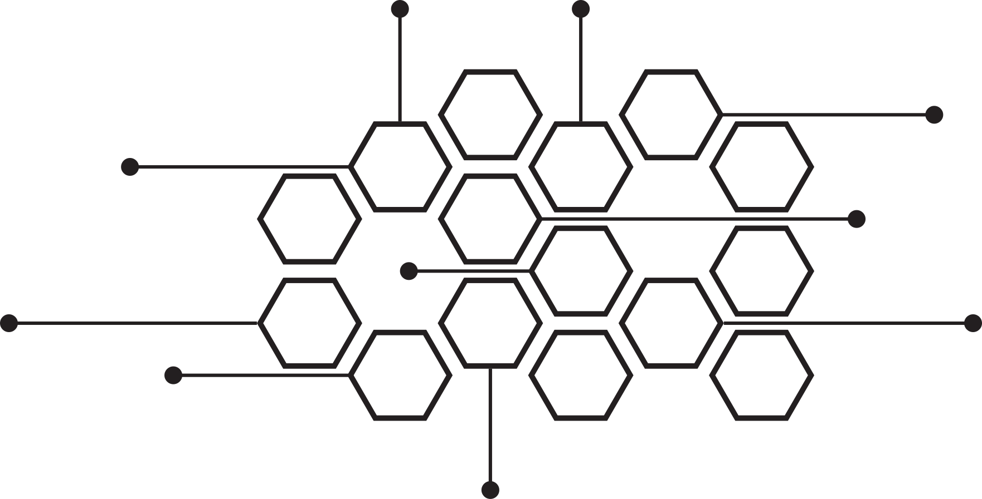

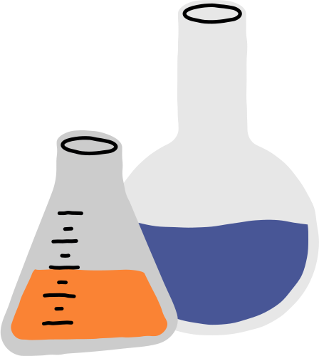

FLOWCHART
FEEDSTOCK PREPARATION
Benzene Formation:
Dehydrogenation of cyclohexane :
C6H12 → C6H6 + 3H2
Toluene Formation:
Dehydrogenation of Methylcyclohexane:
C7H14 → C7H8 + 3H2
Isomerization of Xylene:
C8H10 → C7H8 + CH4
Xylene Formation:
Dehydrogenation of Ethylbenzene:
C8H10 → C8H8 + H2
Isomerization of Ethylbenzene to form ortho-, meta-, and para-xylene:
C8H10 → C8H10
Methylation of Toluene:
2C7H8 + C2​H4 → C8H10 + C2H6
Exposure to Catalyst
Isomerization of paraffins
Cyclization of paraffins to naphthenes
REACTIONS
Product Separation
Dehydrocyclization of paraffins to aromatics
Extraction
Distillation
FINAL PRODUCT RECOVERY
Catalyst Regeneration

Slide 10

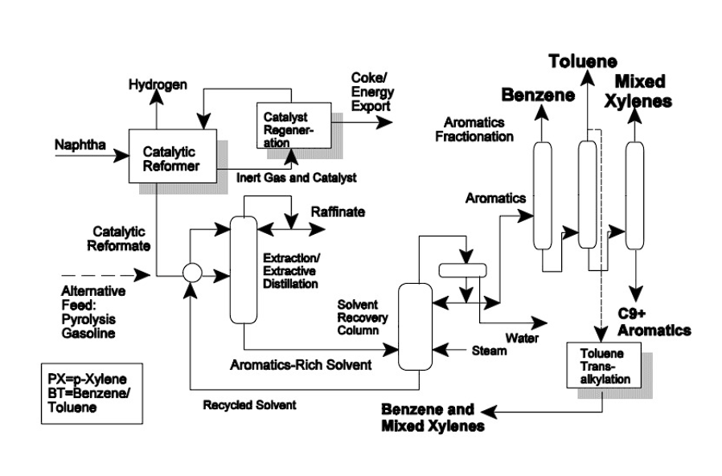

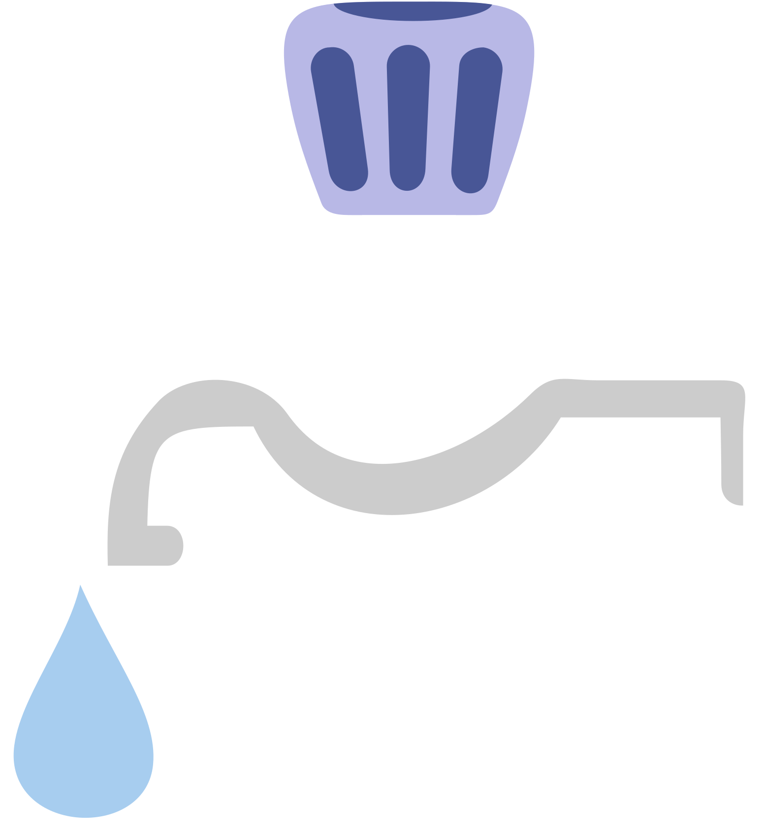



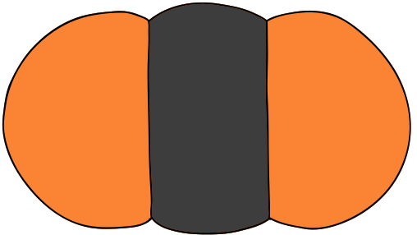










Catalytic Reforming of Naphtha

Slide 11



Steam Cracking of Hydrocarbons
Steam cracking is a pivotal process in the petrochemical industry, where hydrocarbon feedstocks like light liquid hydrocarbons or naphtha are thermally decomposed at high temperatures in the presence of superheated steam.
This process occurs within a cracking furnace, where carbon-carbon bonds within the hydrocarbon molecules are broken, generating highly reactive free radicals. These radicals quickly react to form intermediate species, including aromatic hydrocarbons such as benzene, toluene, and xylene (BTX).
After rapid cooling to stabilize the products, the mixture undergoes separation to isolate the desired BTX compounds, which are then collected for various industrial applications.

Slide 12
FLOWCHART
FEEDSTOCK PREPARATION
Feedstock Dilution with Steam
Benzene Formation:
Thermal Cracking of Cyclohexane :
2C6H12→C6H6+C6H14
Toluene Formation:
Thermal Cracking of Heptane:
C7H16→C6H5CH3+CH4
Xylene Formation:
Thermal Cracking of Octane:
C8H18→C6H4(CH3)2+C2H4
HEATING IN FURNACE
Cracking Reactions
QUENCHING AND PRODUCT SEPARATION
Product Recovery

Slide 13
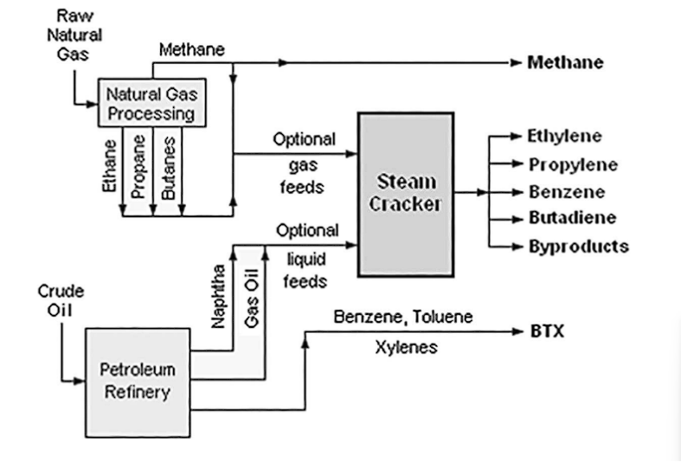
Steam Cracking of Hydrocarbons

Slide 14
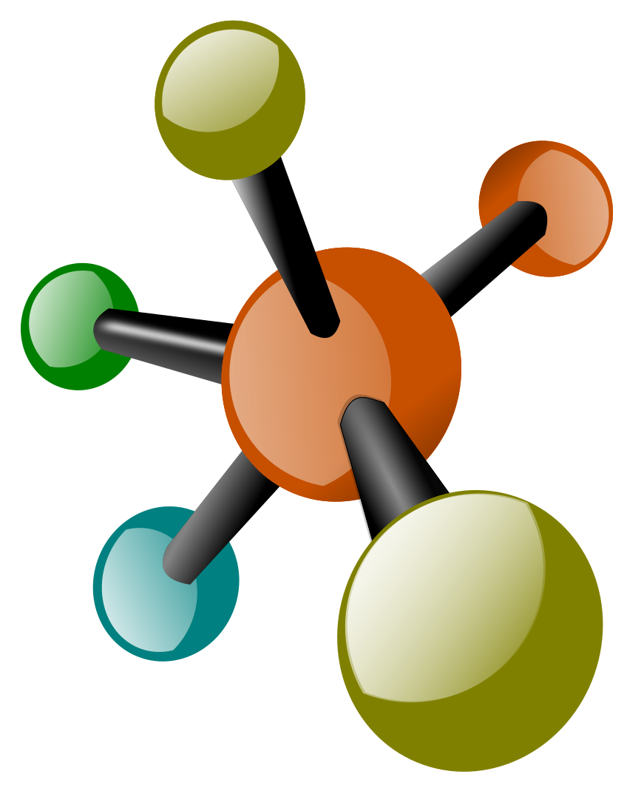
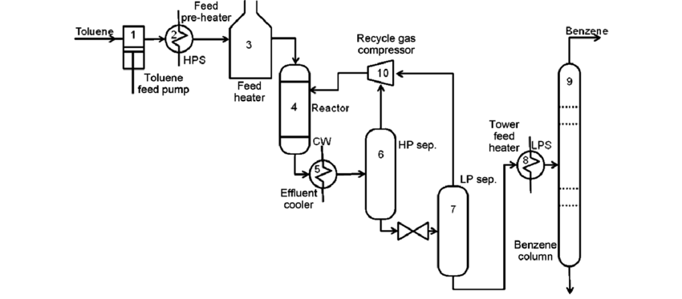
Hydrodealkylation
A method of converting toluene and dialkylbenzenes to benzene. This process involves the removal of alkyl groups (usually methyl groups) from the aromatic ring through catalytic hydrogenation.Hydrodealkylation is an important industrial process for the production of benzene.
Chemical Reactions:
C6H5CH3 + H₂ → C6H6 + CH4
C6H4(CH₃)2 + 2H2 → C6H6 + 2CH4
Process Description:
Compressed hydrogen-rich makeup and recycle gases combine with liquid alkyl aromatic feedstock after preheating. Processing occurs in a reactor, which may contain fixed bed catalyst or be tubular and non-catalytic. Effluent is cooled, separated into gas and liquid fractions, with much of the gas recycled. Liquid fraction is stripped of residual gas, fractionated to yield high-purity benzene, and recycle alkyl aromatics, achieving 95-98% toluene conversion to benzene.

Slide 15
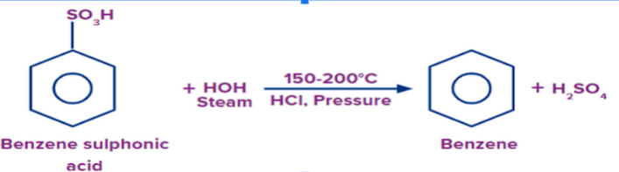
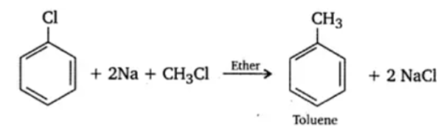
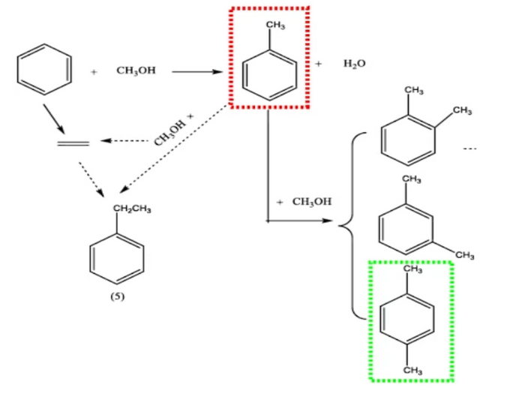
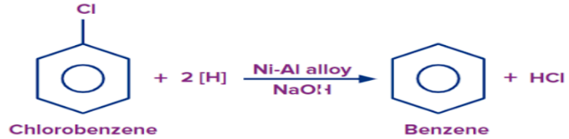
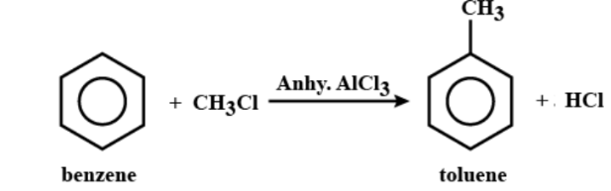
OTHER PROCESSES OF PRODUCTION OF BTX
Benzene
Toluene
Xylene
From Sulphonic Acid
Wurtz Fittig Reaction
Aromatic Alkylation
From DichloroBenzene
Friedel-Crafts Reaction

Slide 16
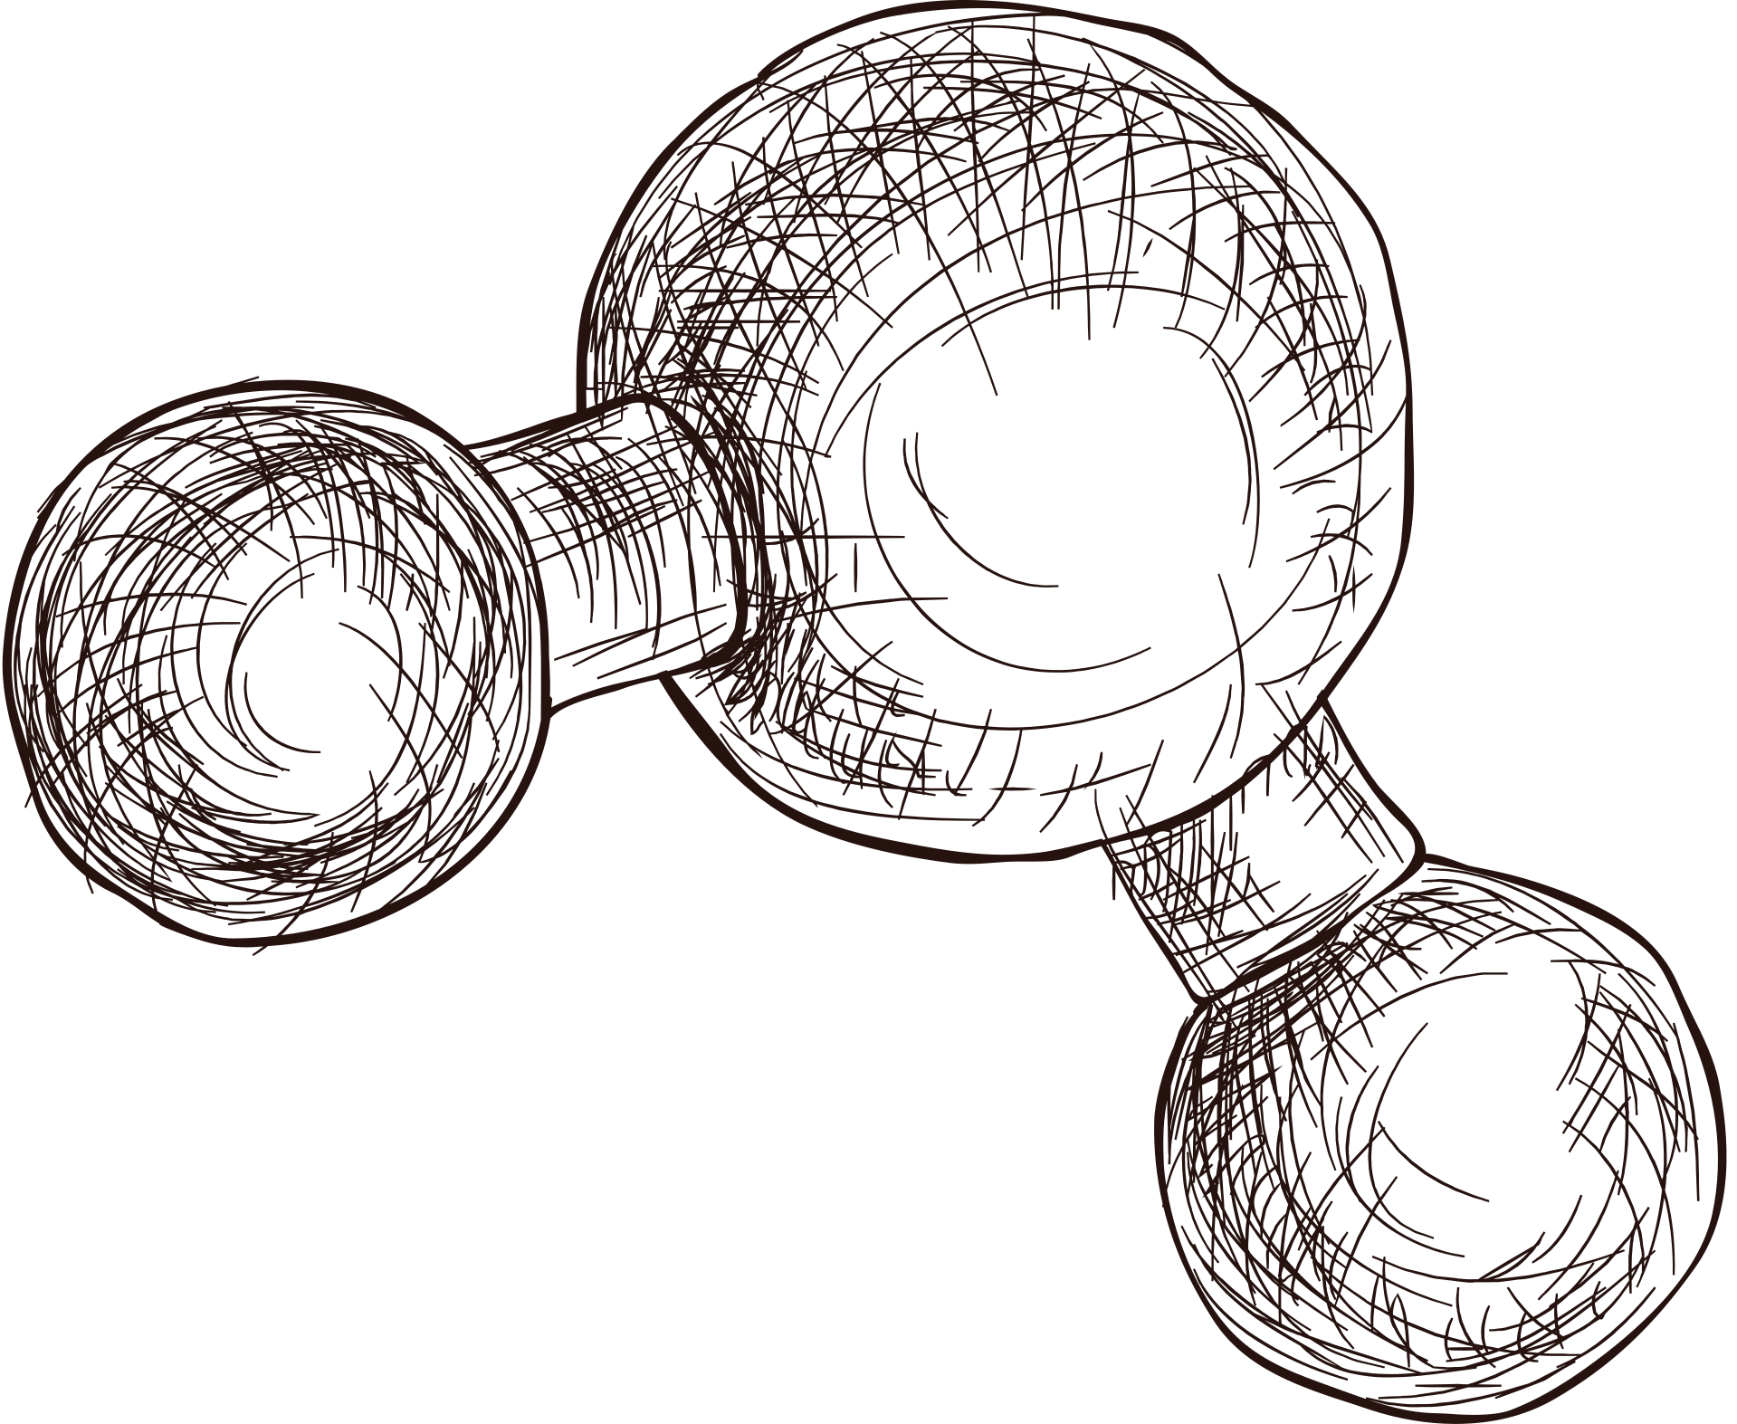
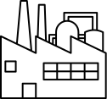


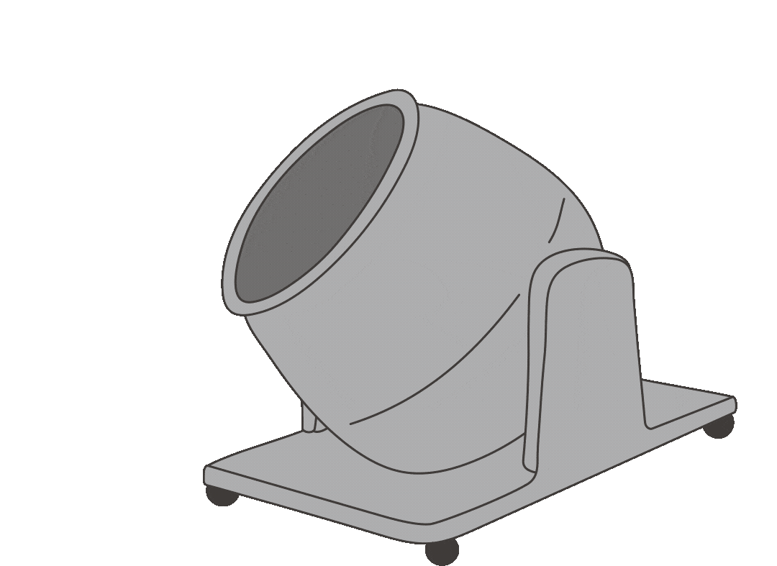
APPLICATIONS OF BTX IN INDUSTRIES
B
1
Solvent: Toluene and xylene are widely used as solvents in various industries, including paint and coatings, adhesives, rubber, printing inks, and pharmaceuticals.
D
2
Fuel Additive: Toluene is sometimes used as an octane booster in gasoline. It improves the octane rating of gasoline and enhances engine performance.
3
O
Feedstock for Chemical Synthesis: Benzene, toluene, and xylene are important raw materials for the production of various chemicals,plastics, synthetic fibers (such as polyester and nylon), resins, detergents, pesticides, pharmaceuticals, and explosives (such as TNT - trinitrotoluene).
4
U
Rubber and Tire Manufacturing: Toluene is used in the production of synthetic rubber, which is used in the manufacturing of tires, conveyor belts, hoses, and other rubber products.

Slide 17
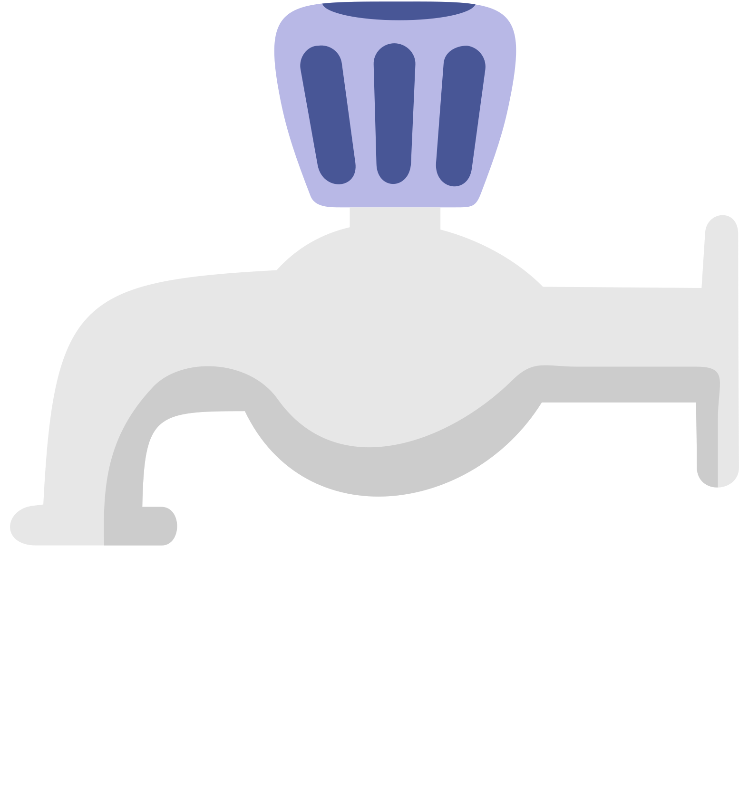
REFERENCES
H₂O
https://wayback.archive-it.org/all/20131021081308/http://www1.eere.energy.gov/manufacturing/industries_technologies/chemicals/pdfs/profile_chap4.pdf
https://hsseworld.com/wp-content/uploads/2020/12/Handbook-of-Petrochemical-Processes-2019.pdf
Shreve's Chemical Process Industries,Book by George T. Austin and R. Norris Shreve
DRYDEN'S OUTLINES OF CHEMICAL TECHNOLOGY FOR THE 21ST CENTURY,Book by Gopalarao
NaCl
?

Slide 18

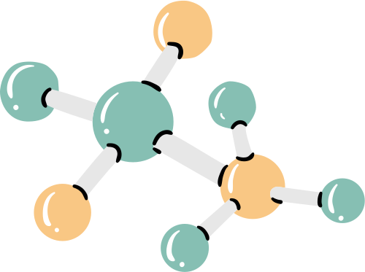


THANKYOU!!

